Slide 1




What do FAIR and Semantic Annotation mean for Chemistry Data?
Stuart Chalk, Department of Chemistry, University of North Florida
Titular member of the IUPAC Committee on Publications and Cheminformatics Data Standards (CPCDS)
Member of the IUPAC Fifth Edition of the Green Book Project on Quantities and Units
Secretary, CODATA Task Group on the Digital Representation of Units of Measurement (DRUM)
Member, CIPM Expert Group on the Digital SI (advising the Task Group on the Digital SI)
University of Southampton, March 15th, 2023

Slide 2
Workshop Overview
09.30 - 10:00 am Coffee, registration & intro briefing (common room)
10:00 - 11:10 am Session 1: FAIR, Chemical Data, GitHub and Python for Data Science
11:10 - 11:25 am Coffee Break
11:25 - 12:30 pm Session 2: Django, SQLite, Data Model, Ingesting Data, Linking Data
12:30 - 13:30 pm Lunch (common room)
13:30 - 14:45 pm Session 3: Creating a Data Website, Exporting Data in JSON
14:45 - 15:00 pm Break
15:00 - 16:00 pm Session 4: Creating Semantic Data as JSON-LD and RDF, Wrap Up
This is not just about coding, its about how we should carefully manage our data!

Slide 3
Chemical Data ‘State of the Art’
How do we generate/store data?
Write/draw/tape it in lab notebooks, export it from instruments, enter in a spreadsheet/electronic lab notebook, and…
How do we publish data?
Published in research papers (PDF)
As supplemental data in a variety of formats
They are not published at all!
Most published data is ‘the best for proving a theory’
A lot of data is collected with good science but is never seen!

Slide 4
How Does FAIR Impact Chemistry?
FAIR is a set of principles
FAIR is not a technological change, its a culture change
Research data should not be thought of as “only” for the project under which it is generated
We need to appreciate that dark data, fits a theory (or not), can be useful to others – making science more efficient
CRITICAL: Chemistry needs to understand what is means for our discipline to be FAIR

Slide 5
The FAIR Principles
Findable, Accessible, Interoperable and Reusable (FAIR) data is the new paradigm for published data
F – You can find the data (you need metadata to do this)
A – You can access the data (with an appropriate credentials)
I – You can get the data in a format that can be easily parsed
R – You know what the data is and what you can do with it
https://www.go-fair.org/fair-principles/

Slide 6
A FAIR Chemical Example IUPAC “Dissociation Constants” Dataset
Data Sources: Three IUPAC Volumes (Books) on pKa/pKb Data
IUPAC, E. P Serjeant and Boyd Dempsey. Ionisation Constants of Organic Acids in Aqueous Solution; Oxford/Pergamon, 1979
IUPAC, DD Perrin. Dissociation Constants of Organic Bases in Aqueous Solution; Butterworths, 1965
IUPAC, DD Perrin. Dissociation Constants of Organic Bases in Aqueous Solution, Supplement; Butterworths, 1972
With permission, scanned, converted to digital data, checked for accuracy, and curated for accessibility, interoperability, and reusability
Available at: https://doi.org/10.5281/zenodo.7236453
License: https://creativecommons.org/licenses/by-nc/4.0/
Findable: GitHub, Google, Zenodo, Google Dataset Search

Slide 7
A FAIR Chemical Example IUPAC “Dissociation Constants” Dataset
Stats:
7 PDF scanned documents
1500 scanned pages
500 MB size
24,147 data points
8,843 chemical substances
1,113 references
69 methods
FAIR Features
DOI, GitHub repo, License
Descriptions of fields/abbrevs
Detailed description of process
All data in CSV files
References, methods and data in separate files
Indication of data quality

Slide 8
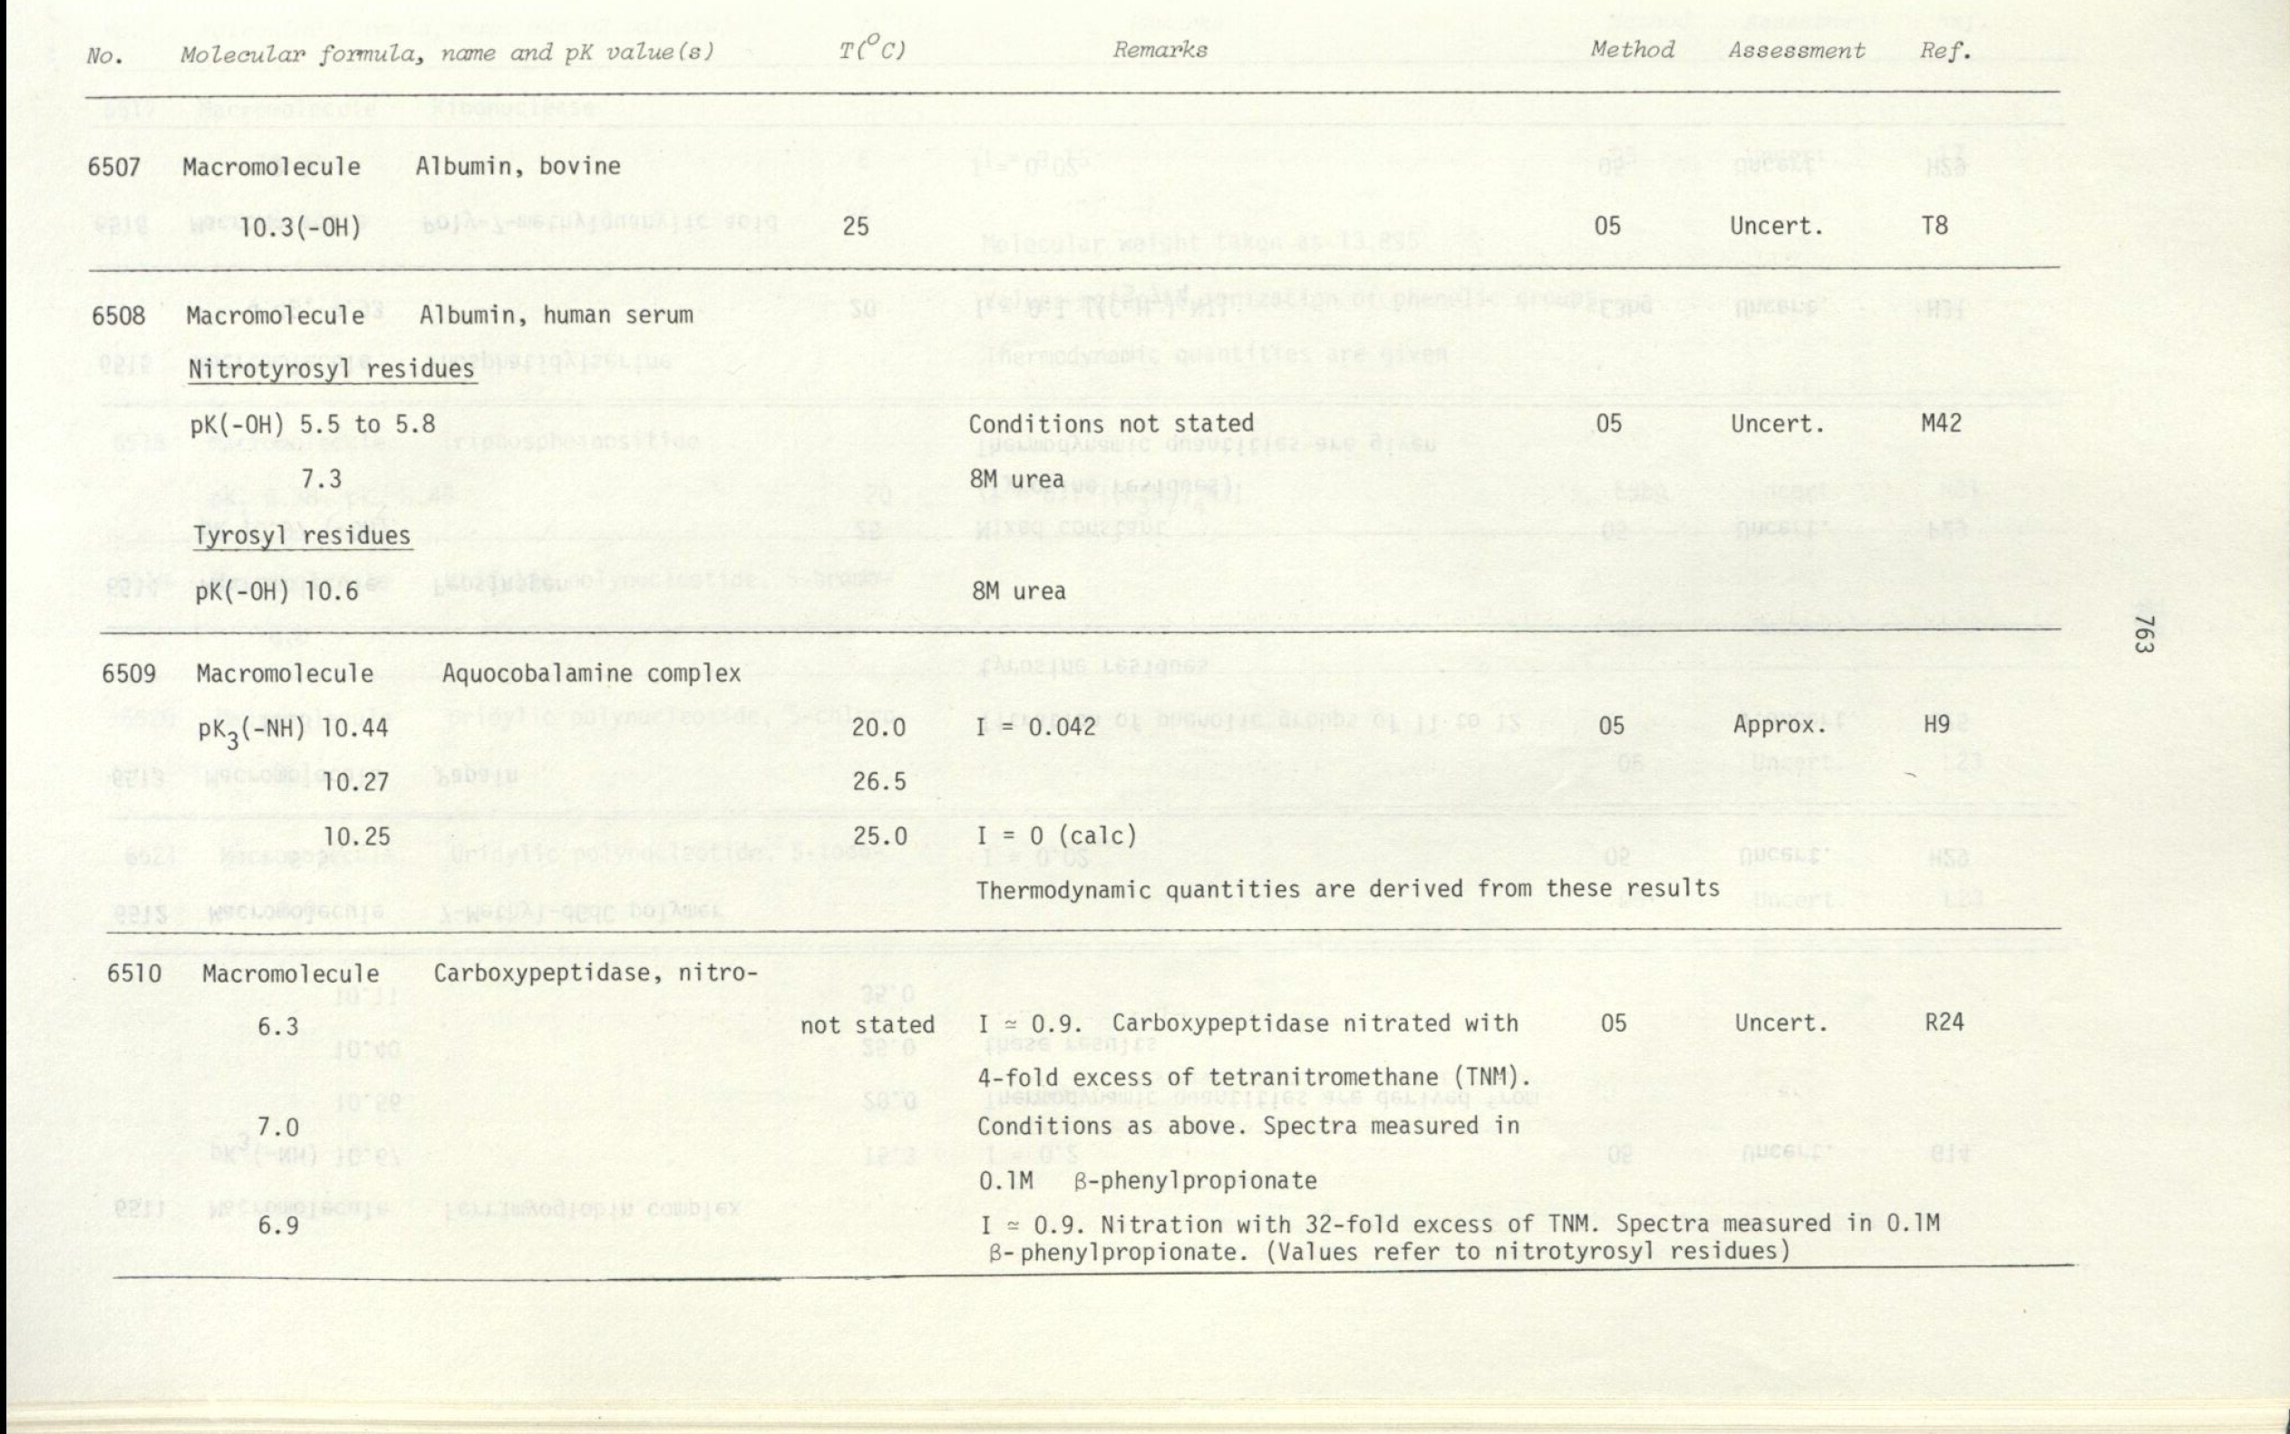
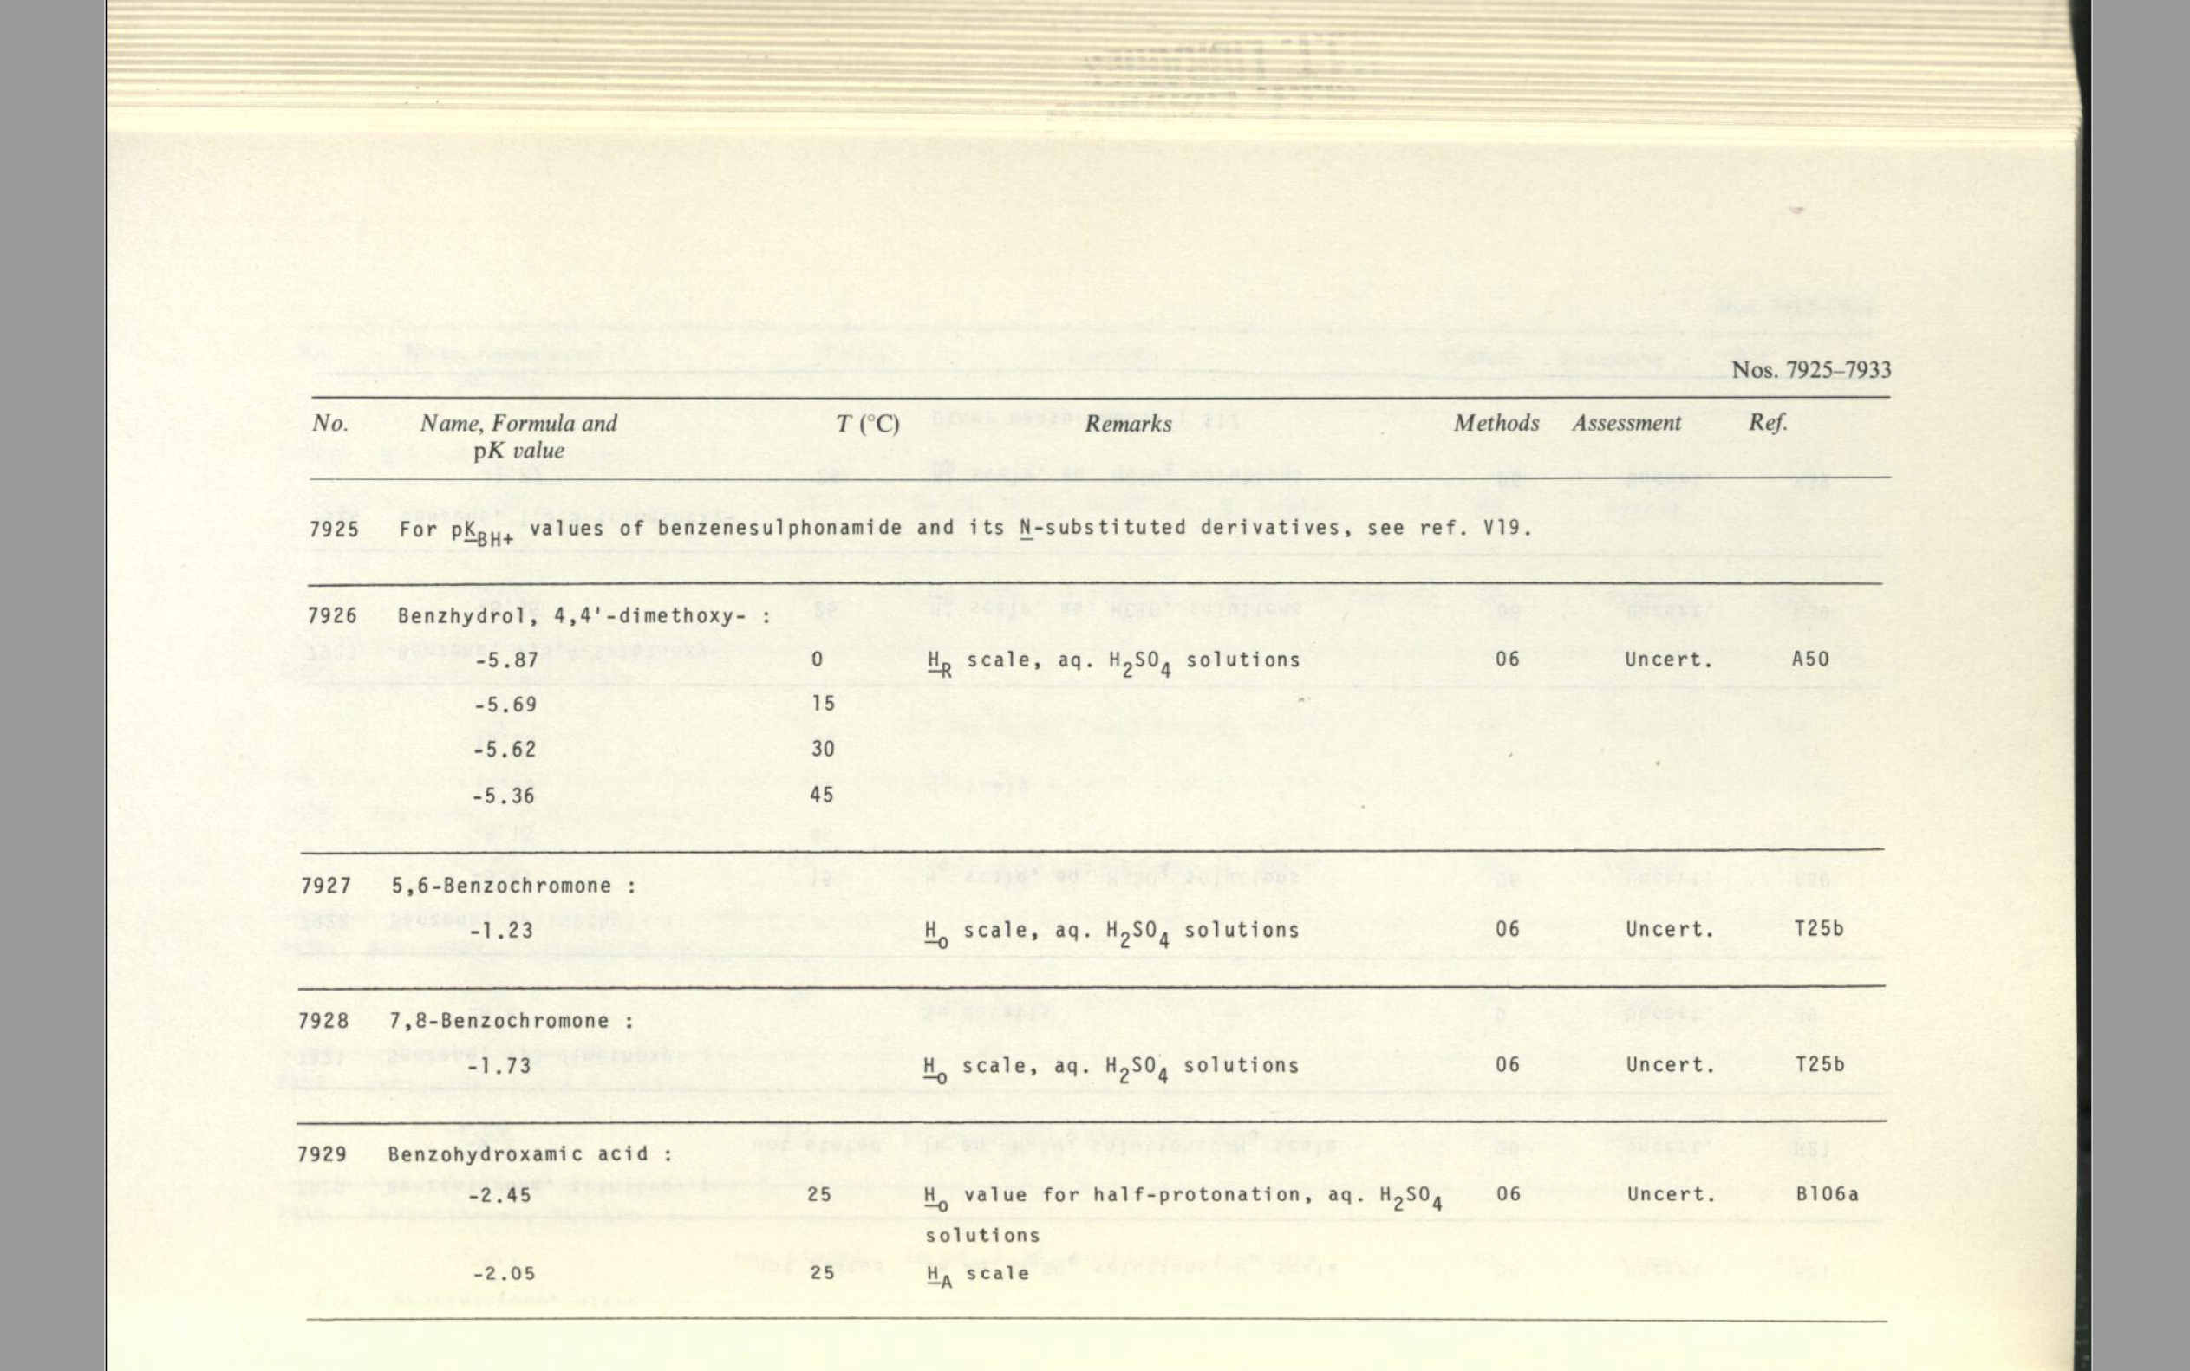
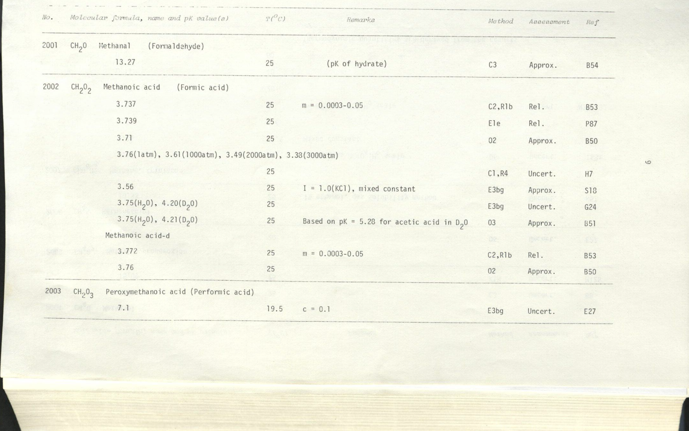
Examples of “Data pages” from original sources.

Slide 9
GitHub: Code and Data Repositories
Git – version control software (any files not just code)
GitHub is a repository website built for Git
Central code/data management/development (with authentication)
Issue tracking – community feedback
Pull requests/Repo Forking – community contributions
Actions – automated actions (i.e., code testing)
Package management, code versioning
Integration with Zenodo to create DOIs for versions (automatically)

Slide 10
Reusing the pKa Dataset
As an example of reuse of dataset, we will:
take data from the pKa dataset
ingest it into a database
augment it with additional data
create a (local) website to allow users to search and export the data
You can then share your website on Heroku (or other hosting services) – not covered here…

Slide 11
PyCharm for Data Science
Python Integrated Development Environment (IDE)
Comprehensive set of features
Python interpreter/package management (UI for pip install)
Code inspection (execution, style, optimization, spelling)
Database access, viewing, editing
GitHub Integration
Free to education (faculty & students - request educational license)

Slide 12
PyCharm Setup
Create account on JetBrains.com using an ‘.edu’ email
Login to GitHub account (make sure you setup 2FA)
Create a personal access token (PAT) – acct settings/developer/pat
In GitHub (or GitLab) fork this repository (get you own copy)
https://github.com/stuchalk/FAIR_Workshop
Login to PyCharm with your JetBrains account
In PyCharm add a project from GitHub (Fork URL)
Add a ‘pipenv’ interpreter (set of needed Python packages)

Slide 13
Django Overview/Setup
Python framework to build REST style websites
Built using ‘apps’ – functions for one part of website (DB table)
urls.py file -> define the urls that correspond to functions in code
views.py file -> code to define action that sends data to webpage
templates (.html) -> take data and create webpage
Database modelling for table(s) creation (we need four)
pKa data, chemical substances, methods, references

Slide 14
Python Coding
Follow along with coding when going over in detail
More complicated code will be shared via this Google Doc https://docs.google.com/document/d/1IQzvEU9tk-t1lm1igK21S-FsElUskjlianJlu1e28cI/edit?usp=sharing
Questions/clarifications always welcome…

Slide 15
Section 2 – Ingesting the Data
To build a website for the dataset we need to upload the data into a database
We will use SQLite as it is ‘built-in’ with Django, but you can use many types of databases
We will create and run ‘ingest.py’ scripts for each of the database tables
If things don’t work, don’t worry you will get a full copy of the database before the next section

Slide 16
Section 2 – Ingesting the Data
In order to add the data, we also need understand the data model
Dissociation Constant Data
has one
one to many
has one
(needs join table)
Chemical Substance
Journal paper
Measurement Method

Slide 17
Section 2 – Ingesting the Data
Create Python scripts to import the data into the database
methods first as it is the simplest
references, get DOI from crossrefapi using 50% cutoff on score (script may take a while)
substances, get metadata from PubChem and confirm substance via OPSIN function, by InchiKey comparison
data, link data to other tables by adding substance_id, method_id, and reference_id fields to table model

Slide 18
Section 3 - Creating the Website
Apps need 'views' of data from respective data tables
References: list of references, view a specific reference
Substances: list of substances, view a specific substance
Data: view a list of data for a substance from a reference (access this via the substances or references view pages)
Finally, we will add a JSON export function

Slide 19
Section 3 - Creating the Website
Remember, urls.py pages define the URL formats
App views.py files define the code to grab data and send it to a template file
The template files add the data to HTML for subsequent display in the browser

Slide 20
Section 3 - Creating the Website
Template files also include CSS, JavaScript, and/or images
The templates/base.html file has the navbar and a space for page content
The templates/home.html file is the homepage
The app template files load content into base.html

Slide 21
Section 4 - Semantic Data
Resource Description Framework (RDF) is the format to do knowledge representation
RDF is constructed using subject-predicate-object triples, the minimal way to represent knowledge, e.g., StuartChalk isVolunteerFor “IUPAC”
There are many ways to encode RDF – we will used JSON from linked data (JSON-LD)
https://www.w3.org/TR/json-ld/

Slide 22
Section 4 - Semantic Data
Here we create JSON-LD in the SciData framework format
SciData organizes scientific data in a generic way
The content of the file is separated into sections: Methodology, System, and Dataset
We can use the scidatalib Python package to create the JSON-LD in the SciData framework format
https://stuchalk.github.io/scidata/

Slide 23
Contacts and Questions
Email: schalk@unf.edu
LinkedIn: https://www.linkedin.com/in/stuchalk
ORCID: http://orcid.org/0000-0002-0703-7776
Thanks for being part of the Workshop!

